Slide 1



has
Who has your books?

Slide 2
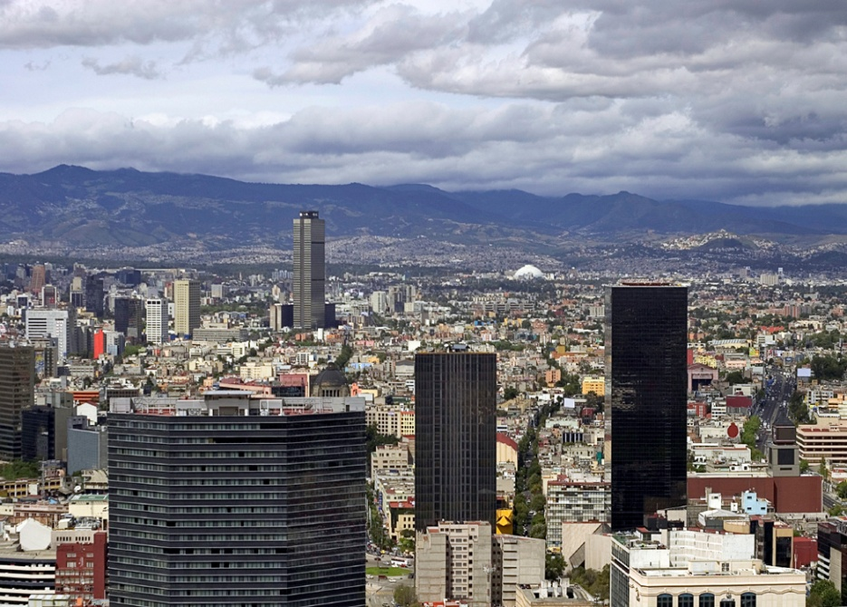
live
I live in Hong Kong.

Slide 3
thank
Thank you very much.

Slide 4
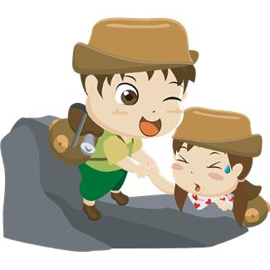
would
Would you help me?

Slide 5

very
I am very tired.

Slide 6

your
Is this your book?

Slide 7
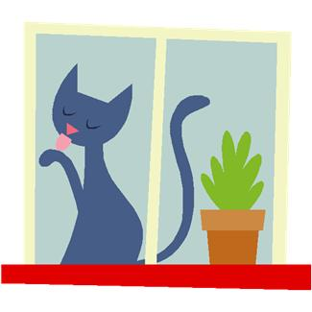

its
The cat licked its feet.

Slide 8
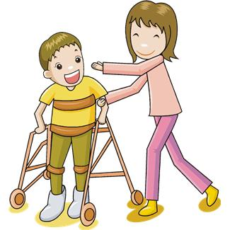
around
Let’s walk around together.

Slide 9

don’t
Please don’t run.

Slide 10
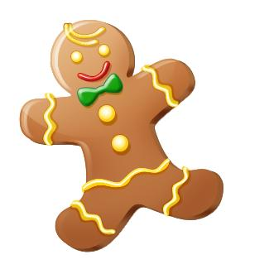

right
+
=
That is the right answer.

