Slide 1
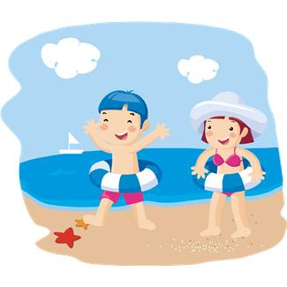
us
Look at us. We are swimming.

Slide 2
buy
I will buy a new computer.

Slide 3
those
Put those books on the desk.

Slide 4
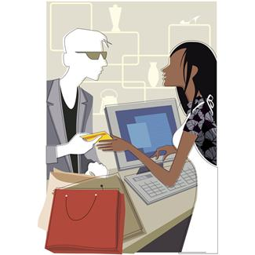
use
Please use your own money.

Slide 5
fast
Run! Run as fast as you can.

Slide 6
pull
I will pull my cart up the hill.

Slide 7
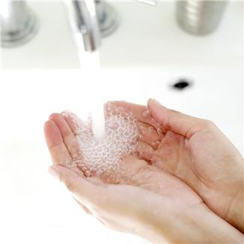
both
Wash both of your hands.

Slide 8
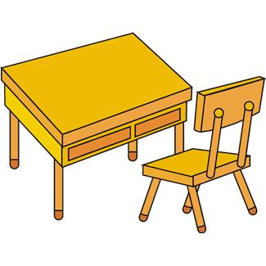
sit
You can sit here.

Slide 9
which
Which one do you want?

Slide 10
read
I read a book.

