Slide 1
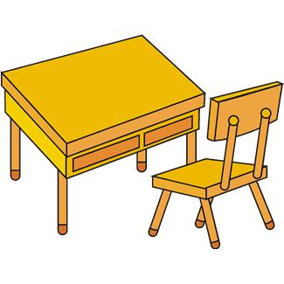
here
You can sit here.

Slide 2
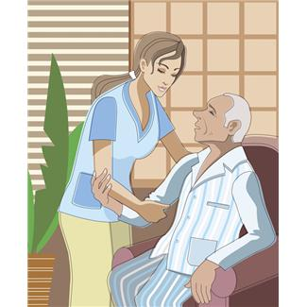
help
I can help you, Grandpa.

Slide 3
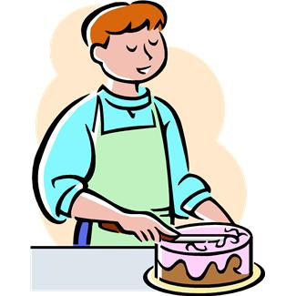
make
I can make a cake.

Slide 4
yellow
The sun is yellow.

Slide 5
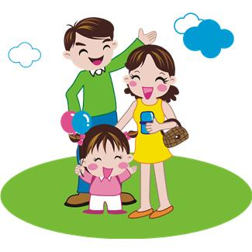
two
1
2
I have two sisters.

Slide 6
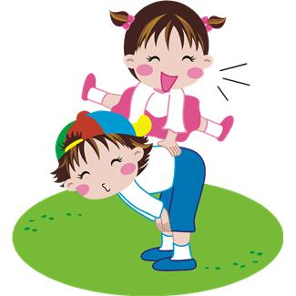
play
I play with my friend.

Slide 7
run
I can run fast.

Slide 8
find
I can’t find my pencil.

Slide 9
three
1, 2, 3
I have three books.

Slide 10
fun
It is fun to play games.

