Slide 1

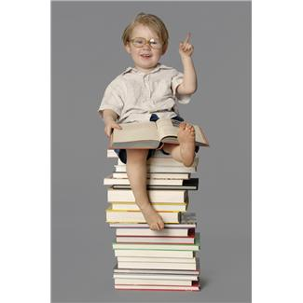
he
He is my little brother.

Slide 2
was
He was running down the hill.

Slide 3

that
I can read that book.

Slide 4
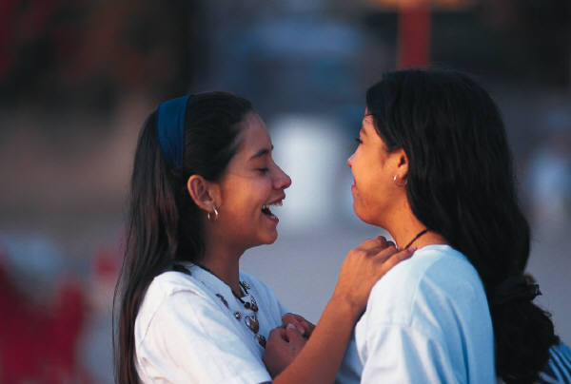
she
She is my friend.

Slide 5
on
I sit on the chair.

Slide 6
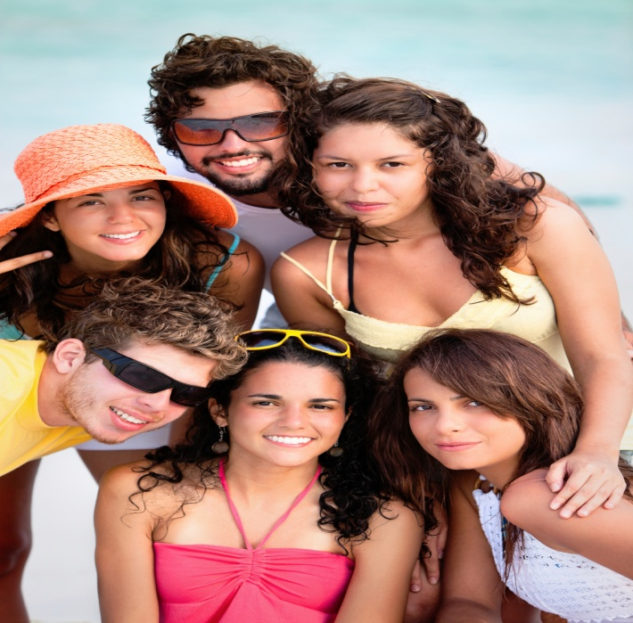
they
They are good friends.

Slide 7
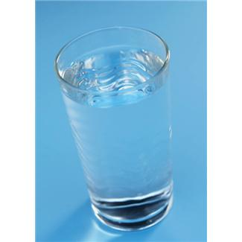
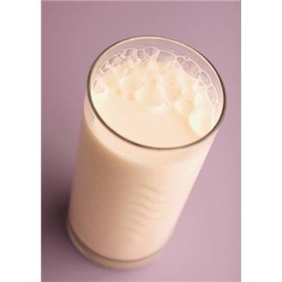
but
I like water but not milk.

Slide 8
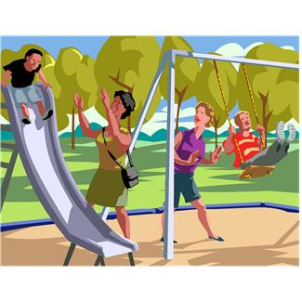
at
I play at the park.

Slide 9
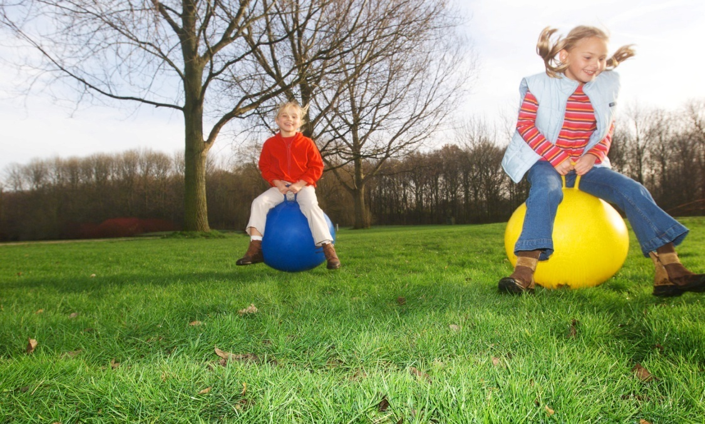
with
I play with my friends.

Slide 10
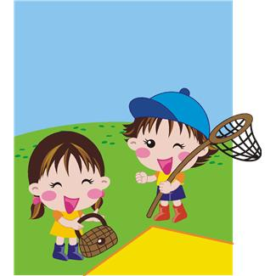
all
We are all happy.

