Slide 1

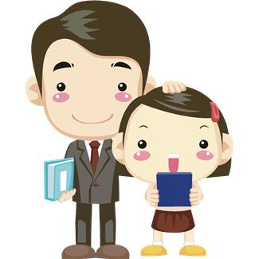
like
I like my teacher.

Slide 2

this
I can read this book.

Slide 3
will
I will be your friend.

Slide 4


yes
I said yes to my mother.

Slide 5
went
I went to school by bus.

Slide 6
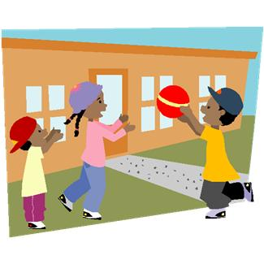
are
My friends are at school.

Slide 7

now
We have Music class now.

Slide 8
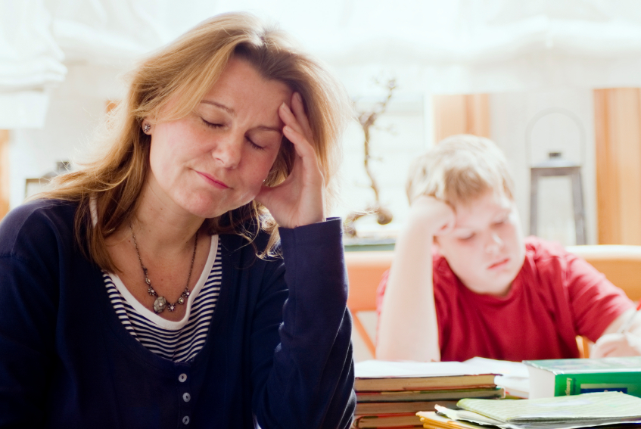
no
My mum says the answer is no.

Slide 9
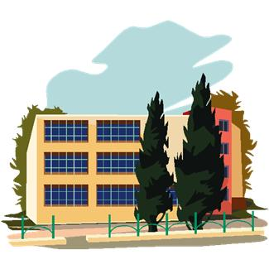
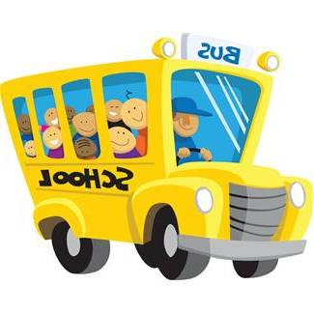


came
I came to school by bus.

Slide 10
ride
I can ride a horse.

